Slide 1
Reading Schools: As it happens
Thank you for joining us. The webinar will begin shortly.
scottishbooktrust.com

Slide 2
Today’s session
Joining us today:
Anna Derricourt, Reading Schools Programme Manager
Liam McCallum, Reading Schools Project Manager
Clara Owen, Reading Schools Co-ordinator
Special guest: Jodie Logan, Wiston Primary School
Session outline:
Short recap of ‘Introduction to…’ session
Step by step guide to becoming a Reading School
Interview with our guest speaker on their Reading Schools journey
Reading Schools framework, submission requirements, examples
Next steps
Questions
scottishbooktrust.com

Slide 3
Recap from previous session
www.readingschools.scot hosts information, resources and project management platform
The Reading Schools Framework includes Key Areas crucial to building and sustaining a whole-school reading culture
The Key Areas are mapped against HGIOS4 and detail the core actions necessary to becoming a Reading School and advance to silver and gold level
To be accredited, you provide evidence of how you have achieved the standard for each Key Area
Your accreditation lasts for 3 years
scottishbooktrust.com

Slide 4
Accreditation levels
Core: the foundational work key to building a reading culture in school, focused on sustainable reading routines and the school environment
Silver: additional opportunities for broadening learners’ experiences, e.g., engaging with authors, visiting libraries, and bringing in outside expertise
Gold: sharing your enthusiasm and expertise with your community through, for example, intergenerational book projects or local partnerships with other schools and businesses
scottishbooktrust.com

Slide 5
How to become a Reading School
scottishbooktrust.com

Slide 6
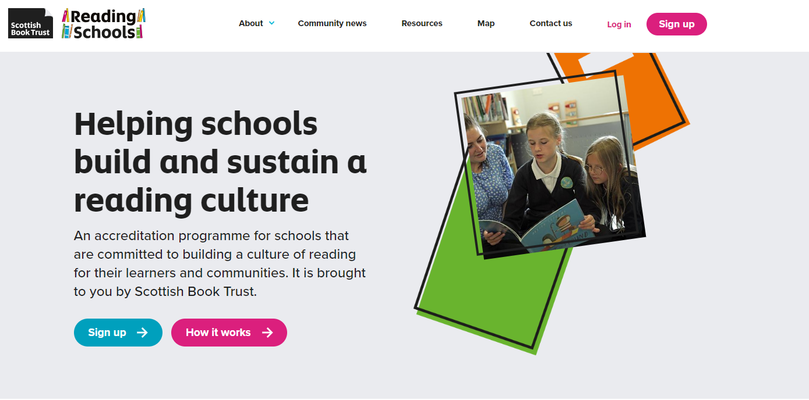
Step 1: Reading Schools website
One-stop-shop, information, resources and project management
Sign up and create a lead contact user account
Familiarise yourself with the resources (‘how to’ videos…)
scottishbooktrust.com

Slide 7
Step 2: Explore the framework
The Framework links to your action plan
Refer to the framework and your action plan throughout the year
The Framework shows each accreditation level side-by-side so you can see what the different expectations are
Understand where your school meets each key area
Each key area has a ‘webinar short’ resource (<6 minutes)
scottishbooktrust.com

Slide 8
Will it be Core, Silver or Gold?
Staff and pupil attitude surveys using our templates
‘What are we doing well?’ Self evaluation
Are there any areas for improvement?
Take your level quiz and compare that with what your school is telling you
scottishbooktrust.com

Slide 9
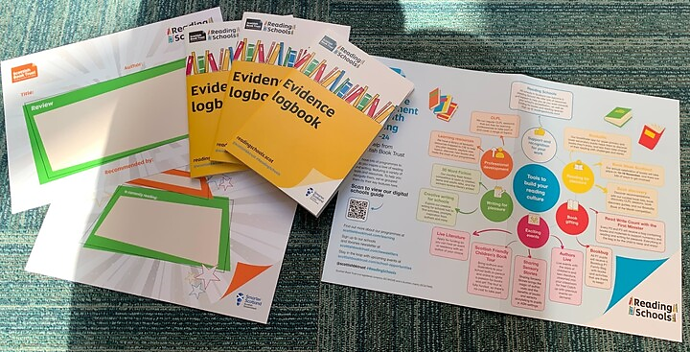
Step 3: Gather your team and share the news
A whole school approach – staff and learners (assembly)
Share intro video (5 minutes) with all staff and colleagues
Use web navigation videos (6 minutes)
Access print out resources to get everyone excited and to feel like a Reading School
scottishbooktrust.com

Slide 10
Step 4: Writing your action plan
Work through with your learners using resources
scottishbooktrust.com

Slide 11
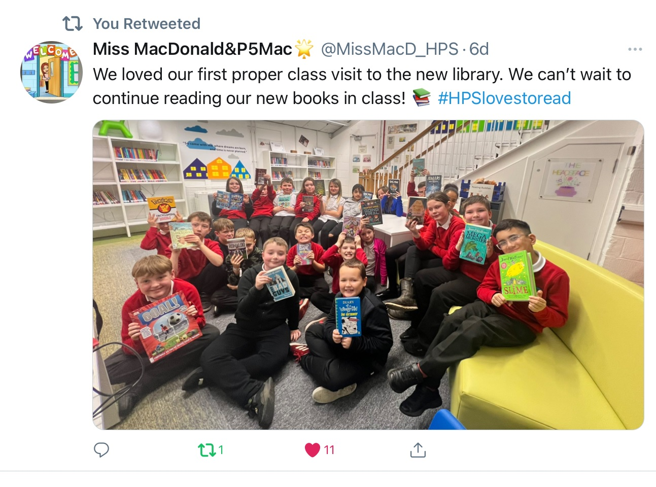
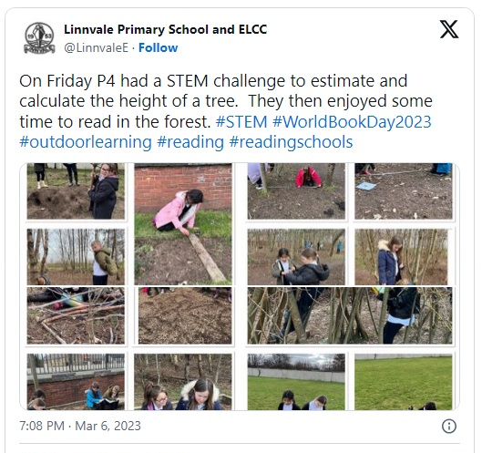
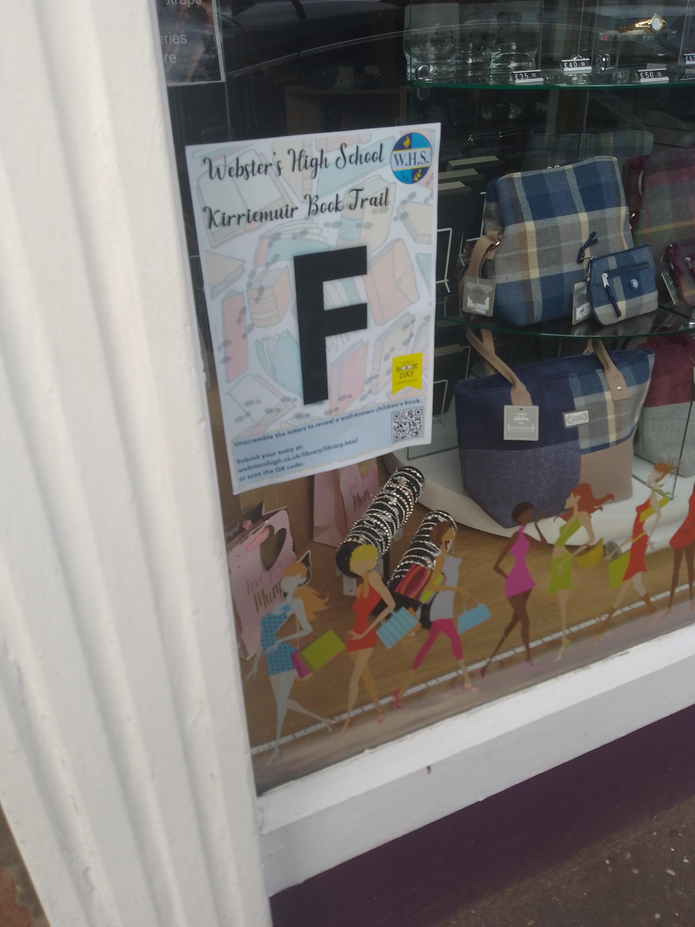
Step 5: Have fun! (Mandatory)
Put your plans into action
Share your journey using #readingschools
Enjoy it and gather evidence as you go
1.3.2 School environment
Core Silver Gold
scottishbooktrust.com

Slide 12
Interview Section
Special Guest
Jodie Logan
Wiston Primary School
scottishbooktrust.com

Slide 13
Framework, requirements and examples
scottishbooktrust.com

Slide 14
The framework
Reader role modelling
Staff development
School environment
Access to high quality books
Interdisciplinary book projects
Creating social networks
Engaging with authors
Responding to reading
Raising the profile of reading with families
Rewarding progress and recognising personal achievements
1.2 Leadership of Learning
1.3 Leadership of Change
1.5 Management of resources to promote equity
2.2 Curriculum
2.3 Learning, Teaching and Assessment
2.5 Family Learning
2.7 Partnerships
3.2 Raising Attainment and Achievement
“The framework is robust and relevant – flexible enough to encompass a whole array of different approaches within individual schools and authorities”
– Dr Janet Adam, FVWL RIC
scottishbooktrust.com

Slide 15
1.2 Leadership of Learning - Reading leadership group - Learner role modelling - Staff as readers themselves - Staff development - Staff knowledge of contemporary children’s Literature
scottishbooktrust.com

Slide 16
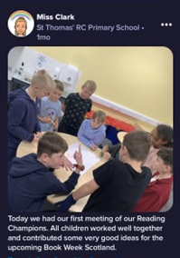
1.2.1 Reading leadership group
We expect Reading Schools to form a reading leadership group who input into your action plan and meet regularly to discuss progress and ideas.
Evidence requirements:
Comments or observations, including details of who was in the group and how often you met
Upload a photo of a meeting
Core / Silver Gold
scottishbooktrust.com

Slide 17
2.2 Curriculum - Regular opportunities to read for pleasure - Interdisciplinary book projects
scottishbooktrust.com

Slide 18
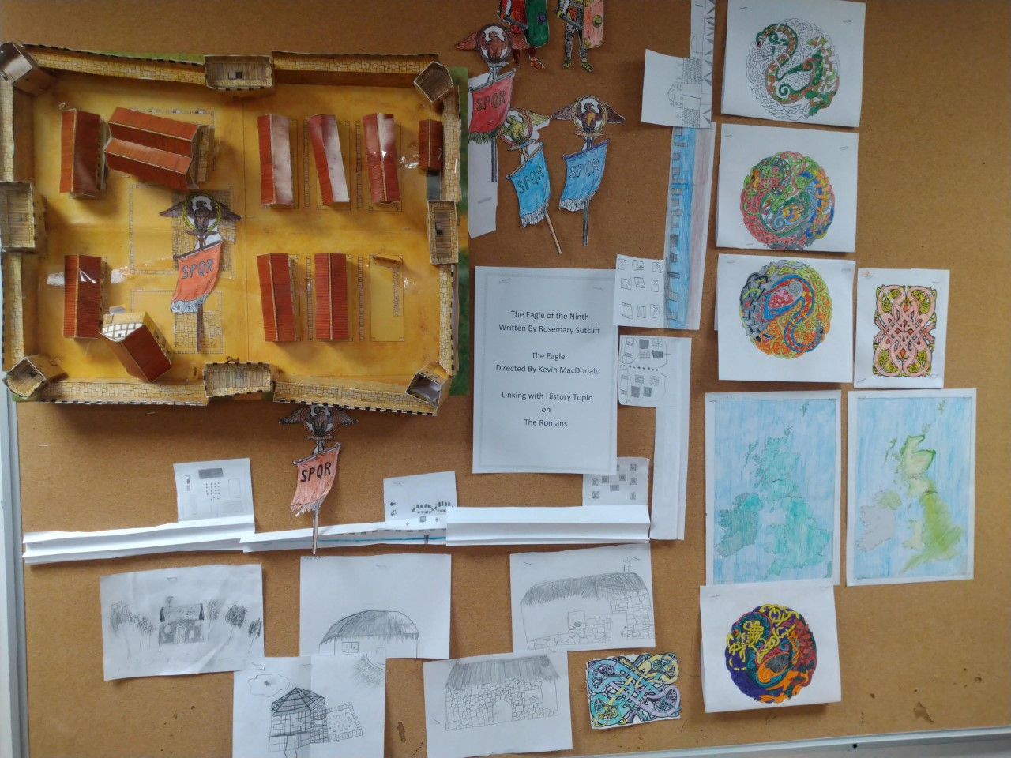
2.2.2 Interdisciplinary book projects
We expect Reading Schools to offer exciting and engaging cross-curricular projects based around books that will inspire learners to read.
Evidence requirements:
Comments or observations
Upload photos or examples of learners' work from different classes
Core Silver
scottishbooktrust.com

Slide 19
2.5 Family Learning - Raising the profile of reading with families
scottishbooktrust.com

Slide 20
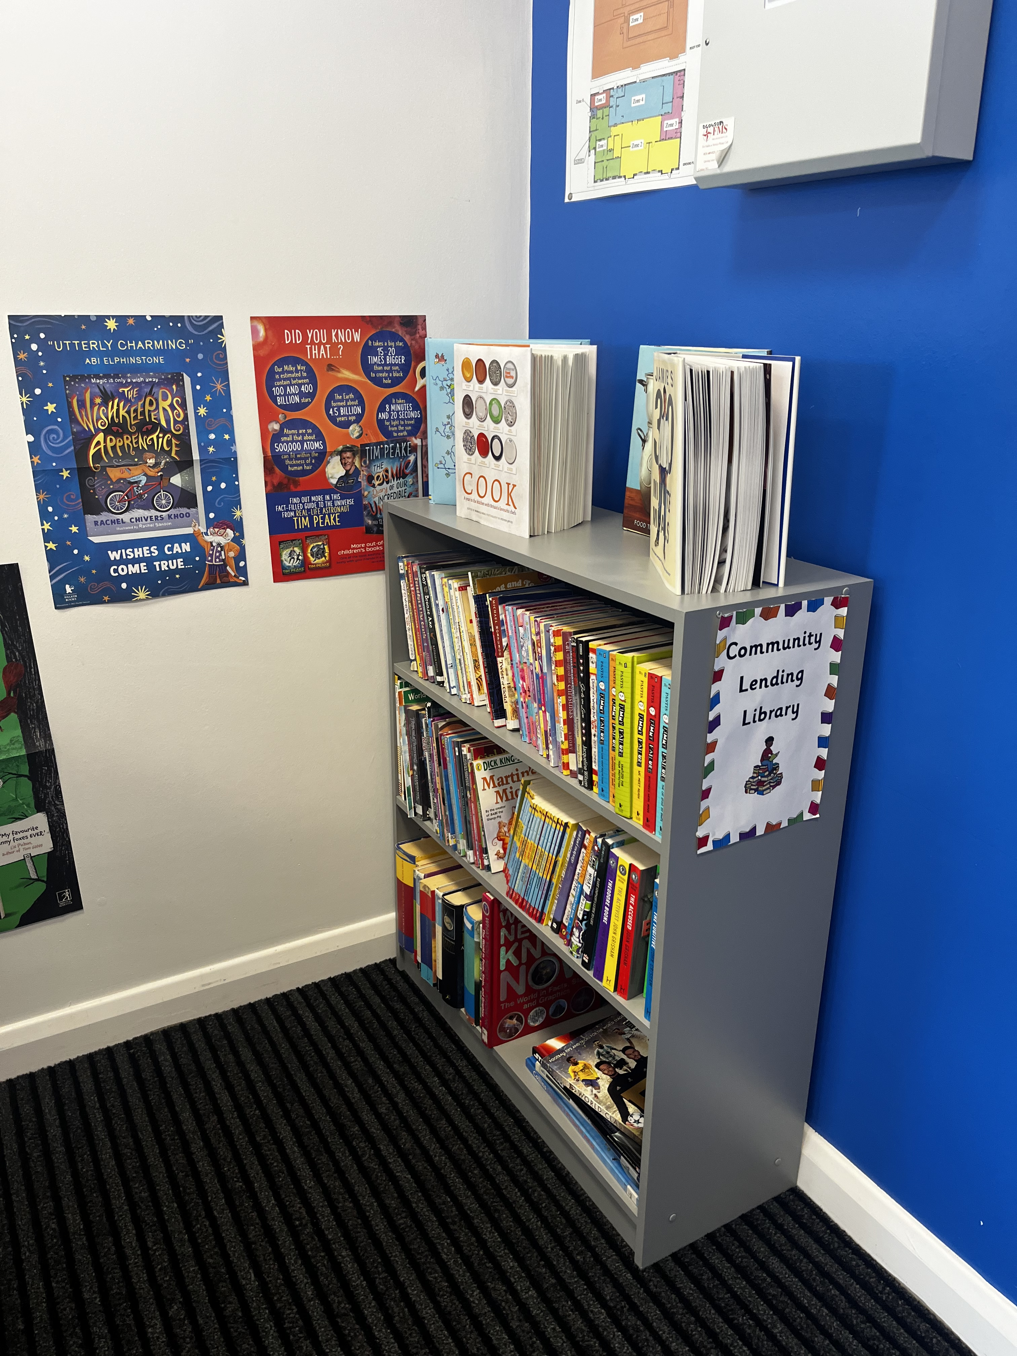
2.5.1 Raising the profile of reading with families
We expect Reading Schools to involve learners’ families in building their reading culture.
Evidence requirements:
Comments or observations, on at least one activity completed per accreditation level
Provide a few quotes from families that attended events/ took part in the initiatives
Upload photos of family events / initiatives (Primary only)
Core Silver Gold
scottishbooktrust.com

Slide 21
Preparation is key
Preparation is key to the success of your Reading Schools journey
Assemble your key players across the school, learners, colleagues and management
Make sure your plans are realistic and achievable, with your learners' input
Don't be afraid to change your plans, as long they continue to meet the key area criteria
Ask for support
scottishbooktrust.com

Slide 22
Funding 23/24
Reading & Spaces Fund – opens 15th Sept (£500)
ASN Schools Residencies – Open now (closes 2 Oct)
Sensory Stories Funds (£500) – opening 3rd Oct
Live Literature – funded author visits and residencies (closes 20th Nov)
scottishbooktrust.com

Slide 23
Now you can get started
Visit www.readingschools.scot
Explore the framework
Take our level quiz to decide which accreditation best suits your school
Get buy in from your whole school – learners, colleagues and senior leadership
Form your Reading Leadership Group with students and staff
Plan your CLPL calendar ;
Start your accreditation journey!
scottishbooktrust.com

Slide 24
Upcoming Reading Schools CLPL
The Reading Schools journey:
Submitting your Evidence – Thursday 28 September, 16.30-17.30
Our suite of CLPL will be repeated in Spring 2024
Shared practice events:
Interdisciplinary book projects – Thursday 16 November, 16.30-18.00
Paired reading projects with Read, Write, Count – Monday 25 September, 16.30-17.30 and Monday 2 October, 16.30-17.30
Drop-in sessions (16.00-17.00):
Thursday 21 September
Thursday 2 November
Thursday 30 November
Other Scottish Book Trust CLPL:
Building a reading culture in your classroom – Tuesday 19 September, 16.30-17.30
scottishbooktrust.com

Slide 25
Any questions..?
Pop them in the chat or unmute and speak with us!
scottishbooktrust.com

Slide 26
We appreciate your feedback
Please take a second to complete our quick survey here:
You can find details of the recent changes we've made based on your feedback on our website!
scottishbooktrust.com

Slide 27
Thank you
anna.derricourt@scottishbooktrust.com
liam.mccallum@scottishbooktrust.com
readingschools@scottishbooktrust.com
Scottish Book Trust is a national charity changing lives through reading and writing. Registered company SC184248 | Scottish charity SC027669

