Slide 1



How to use this PowerPoint
Before using this PowerPoint with your colleagues, feel free to edit it with your own ideas, programmes you already run, or any other considerations or context you’d like to add about your school.
We’ve split this PowerPoint into four parts, please feel free to just focus on the area(s) that are most useful to you:
Part 1: Why take part in Reading Schools?
Part 2: What does Reading Schools look like?
Part 3: What do you want to deliver in your school?
Part 4: Next steps
Please note: the Reading Dare game from slide 21 to 29 requires clicking or touching the screen and, as such, may not work with screen assistive technology.
scottishbooktrust.com

Slide 2


Reading Schools
An introduction to delivery in our school
scottishbooktrust.com

Slide 3
Reading Schools
Part 1: Why take part in Reading Schools?
scottishbooktrust.com

Slide 4
What is Reading Schools?
An accreditation that champions the reading culture in your school
Resources, training and support from Scottish Book Trust
Professional development opportunities for staff
A way to champion pupil voice
Opportunities to connect with other schools, families and your wider community
scottishbooktrust.com

Slide 5
Why take part? (1)
Reading for pleasure is the single most important indicator of a child’s future success (OECD, 2002).
Reading for pleasure in all children may support the best possible chance for good cognitive development and mental health (Sun Y-J, Sahakian BJ, Langley C, et al., 2024)
Reading for pleasure has been shown to have benefits on reading skills, spelling, general knowledge and school achievment (Mol and Bus, 2011). Children also report numerous social benefits including hepling them relax, escape reality and develop empathy for others (McGeown et al, 2020).
Reading for pleasure is strongly influenced by relationships between teachers and children and children and families (Cremin et al, 2009).
scottishbooktrust.com

Slide 6
Why take part? (2)
93% of surveyed schools said Reading Schools improved attainment
88% said Reading Schools contributed to reducing or closing the poverty related attainment gap
Pupils reported an increase in reading for pleasure, including a 96% increase for those who didn’t enjoy reading before
Pupils also said it helped them feel calm, peaceful and helped them express their feelings and have a voice to share their passions
scottishbooktrust.com

Slide 7
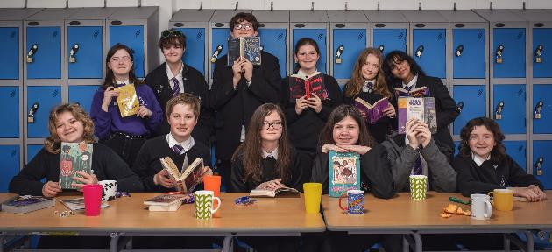
Why take part? (3)
Most of all it can bring a school together around the power of stories.
‘It’s changed the mindset for a lot of children and now they share a love of reading. That’s the project’s legacy. The impact will be long-term.’, Principal teacher, primary school
scottishbooktrust.com

Slide 8
Reading Schools
Part 2: What does Reading Schools look like?
scottishbooktrust.com

Slide 9

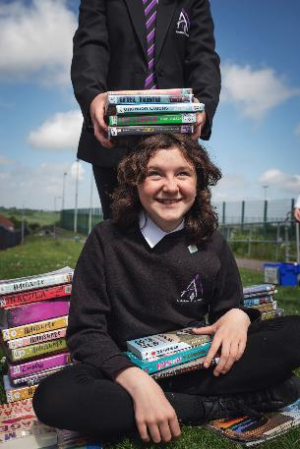
What does Reading Schools look like? (1)
Reading Schools uses a framework based on How Good is Our School? 4.
To receive your accreditation, you must provide evidence that you have delivered each of the Key Areas.
scottishbooktrust.com

Slide 10
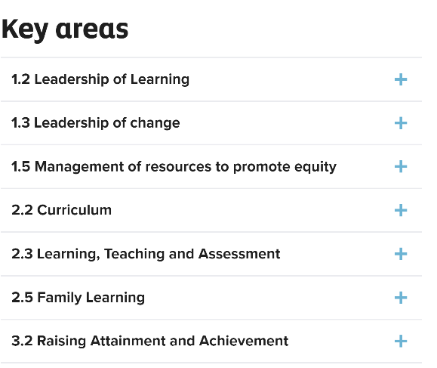
Framework example (1)
This is how the Framework appears on the Reading Schools website
Let’s expand to see one example of a Key Area
scottishbooktrust.com

Slide 11

Framework example (2)
2.2 Curriculum
Key Area 2.2.1 – Regular opportunities to read for pleasure
Ensuring that regular reading for pleasure takes place, reading is integrated into the school day/week and not just used to fill time or reward good work, demonstrating that reading is considered important within the school.
Schools should ensure that all learners have regular time to read texts of their own choosing in one of the below ways, or in another way that suits their setting:
Having regular reading at registration / transition times / other times as appropriate
Holding spontaneous DEAR time (Drop Everything and Read)
Including reading for pleasure time in home learning
scottishbooktrust.com

Slide 12
Framework overview
The Framework covers:
Opportunities for your pupils to access high-quality texts, read for pleasure, and respond to texts
Role modelling and celebrating reading and personal achievements
Creating a reading friendly environment
Staff development and knowledge
Reading across the curriculum and in social networks
Supporting families with reading at home
scottishbooktrust.com

Slide 13
What does Reading Schools look like? (2)
What you deliver for each Key Area can be:
Something you are already doing
Adapted to fit the context of your school and pupils, including pupils with additional support needs
Delivered in languages other than English, for example Scots, Gaelic or when working with pupils who have EAL
For example…
scottishbooktrust.com

Slide 14
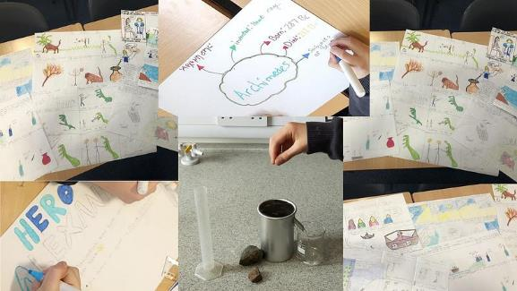

2.2.2 Interdisciplinary book projects
Could look like…
Cathkin High School used Greek myths to inspire their maths lessons and science experiments.
Read more on our website: Interdisciplinary book projects at Cathkin High School
scottishbooktrust.com

Slide 15


2.3.4 Opportunities for learners to respond to what they’re reading
Could look like…
Forfar Academy ran digital projects, where pupils created book reviews, trailers and podcasts.
Read more on our website: Opportunities for learners to respond to what they are reading at Forfar Academy
scottishbooktrust.com

Slide 16
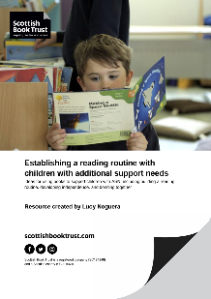
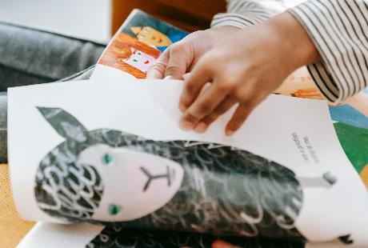

1.3.2 School Environment
Could look like…
Creating inviting reading environments for sensory storytelling using props, stories or book boxes.
Read more on our website: Reading Schools in Additional Support Needs Settings
scottishbooktrust.com

Slide 17
Reading Schools
Part 3: What do you want to deliver in your school?
scottishbooktrust.com

Slide 18

Break out question 1
What do you already deliver?
In pairs or groups, discuss the ways you already celebrate reading in your school.
Identify: WHO is delivering
WHAT they are delivering
Don’t get too lost trying to tie it to the Framework yet – just discuss what you’re doing and what’s working!
scottishbooktrust.com

Slide 19
Break out question 1: Reflections and feedback
What do you already deliver?
Take 5 minutes to feedback on what you discussed.
Keep a note of anything mentioned – this could be part of your Reading Schools submission!
scottishbooktrust.com

Slide 20

Break out question 2
What areas would you like to develop?
In pairs or groups, discuss what areas of a reading culture you think might need more development in your school.
scottishbooktrust.com

Slide 21
Break out question 2: Reflections and feedback
What areas would you like to develop?
Take 5 minutes to feedback. Keep a list of any suggested ideas or actions. What could you feasibly deliver?
scottishbooktrust.com

Slide 22
Reading Schools
Part 4: Next steps
scottishbooktrust.com

Slide 23

Next steps
Who? Decide who will create your online Reading Schools account – they’ll be responsible for creating an Action Plan and uploading evidence. You can have as many contributors as you like, so it’s worth sharing the load!
What level? Take the Level quiz to get a sense of what level you should work towards
Which pupils? Start pulling together your Reading Leadership Group of pupils from across your school who can shape your delivery. You can use our Assembly resource to talk to your pupils about Reading Schools and see who is interested in joining.
When? Plan when you’d next like to meet to discuss what you’d like to deliver or develop.
Families – Let families know you’re starting this journey and why! You’ll need to get them involved.
scottishbooktrust.com

Slide 24
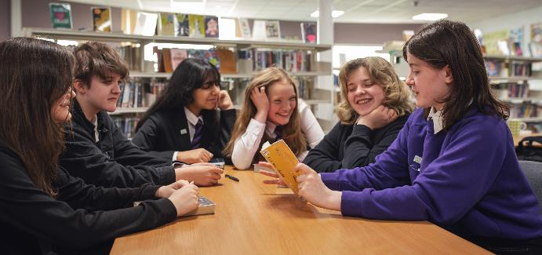
Start your Action Plan
To sign up and start working on your Action Plan, see the Reading Schools website
scottishbooktrust.com

Slide 25
Useful links
The Reading Schools website contains key information, including the Framework, FAQs and our suite of online resources
The Scottish Book Trust website contains further learning resources you can filter by age, curriculum area and more
Visit our School events and opportunities and CLPL webpages for opportunities for you and your school
Check out our online Reading Schools Community to find inspiration from schools across the nation undertaking an accreditation
scottishbooktrust.com

Slide 26
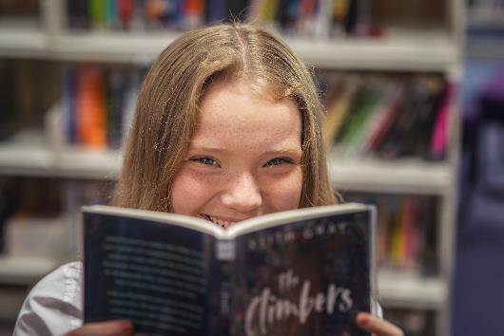
Before you go…
It’s time to set yourself a reading dare! Use the next slide to pick a colour for a random challenge.
scottishbooktrust.com

Slide 27
Set yourself a reading dare
Click on a button below to get a randomized challenge
When you’re ready to move on, click here
scottishbooktrust.com

Slide 28

Set yourself a reading dare (1)
Set up a “I’m currently reading” sign in your classroom
Click on the books below to choose another challenge!
scottishbooktrust.com

Slide 29
Set yourself a reading dare (2)
Print some shelf shouters for your class/school library
Click on the books below to choose another challenge!
scottishbooktrust.com

Slide 30
Set yourself a reading dare (3)
Start a staff book group
Click on the books below to choose another challenge!
scottishbooktrust.com

Slide 31
Set yourself a reading dare (4)
Ask a pupil for a book recommendation and read it!
Click on the books below to choose another challenge!
scottishbooktrust.com

Slide 32
Set yourself a reading dare (5)
Use our “My Life as a Reader” PowerPoint to introduce yourself to your class
Click on the books below to choose another challenge!
scottishbooktrust.com

Slide 33
Set yourself a reading dare (6)
Make yourself an “Ask me what I’m reading” badge and wear it for a week!
Click on the books below to choose another challenge!
scottishbooktrust.com

Slide 34
Set yourself a reading dare (7)
Try a new format or genre
Click on the books below to choose another challenge!
scottishbooktrust.com

Slide 35
Set yourself a reading dare (8)
Print a display a book review poster
Click on the books below to choose another challenge!
scottishbooktrust.com

Slide 36


Thank you
readingschools.scot
Scottish Book Trust is a national charity changing lives through reading and writing. Registered company SC184248 | Scottish charity SC027669

