Slide 1


How to use this PowerPoint
This PowerPoint contains four different activities you can use to support your pupils with creative writing!
Alongside this resource, you can also find a Word Document/PDF on the Reading Schools website which takes you through each activity, including links to Curriculum for Excellence.
Slide 2 and 3: Introduction
Slides 4 to 13: Activity 1: What happened next?
Slides 14 to 30: Activity 2: The story game
Slides 31 to 34: Activity 3: Write the sequel
Slide 35 to 39: Activity 4: A day in the life
scottishbooktrust.com

Slide 2

Alastair Chisholm’s creative writing prompts
scottishbooktrust.com

Slide 3
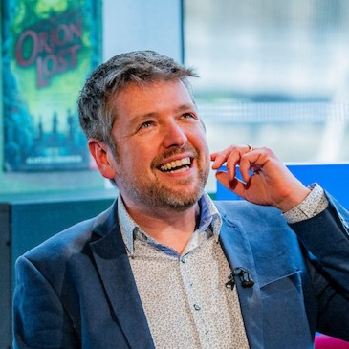




Introduction
Hello, I’m Alastair Chisholm! I’m an author
(you can see some of my books below) as well
as a Reading Schools ambassador.
Today, I’m going to be sharing some activities you can use to come up with your own stories. Are you ready? Let’s jump in!

Slide 4
Activity 1:
What happened next?
scottishbooktrust.com

Slide 5
Activity 1: What happened next?
I’m going to give you five lines from the start of a story. My challenge to you is: can you carry on the story?
scottishbooktrust.com

Slide 6
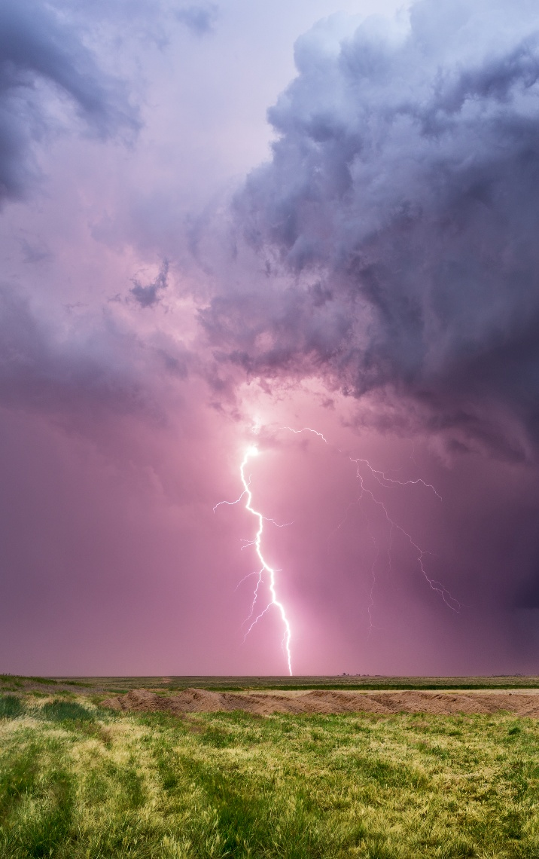
What happened next: Option (1)
I ran for the doorway as lightning flashed all around.
scottishbooktrust.com

Slide 7

What happened next: Option (2)
‘Why are you looking at my book?’ demanded Ellie.
scottishbooktrust.com

Slide 8

What happened next: Option (3)
The engines roared behind me and we blasted into space.
scottishbooktrust.com

Slide 9

What happened next: Option (4)
The forest was silent, but I knew something was following me.
scottishbooktrust.com

Slide 10

What happened next: Option (5)
My phone pinged… and it was her.
scottishbooktrust.com

Slide 11
Wait! Before you start!
Close your eyes. Imagine you are right there inside the story.
What do you think is happening? What can you see? What can you hear? Is there a smell? How would it feel to be there? Is it exciting? Scary? Happy? Sad?
Try to imagine it as hard as you can and then… write it down!
scottishbooktrust.com

Slide 12
Pick your opening line…
I ran for the doorway as lightning flashed all around.
‘Why are you looking in my book?’ demanded Ellie.
The engines roared behind me and we blasted into space.
The forest was silent, but I knew something was following me.
My phone pinged… and it was her.
scottishbooktrust.com

Slide 13
What happened next: share your story!
Now you can share your story with your class or with a partner.
scottishbooktrust.com

Slide 14
Activity 2:
Make a story fortune teller
scottishbooktrust.com

Slide 15
What is a fortune teller?
Using your activity sheet, you’re going to create a fortune teller that will help you tell stories.
scottishbooktrust.com

Slide 16
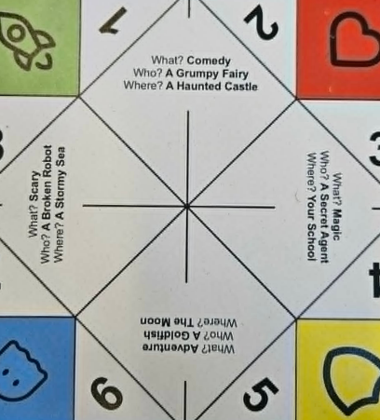
Step 1: Cut out your fortune teller
scottishbooktrust.com

Slide 17
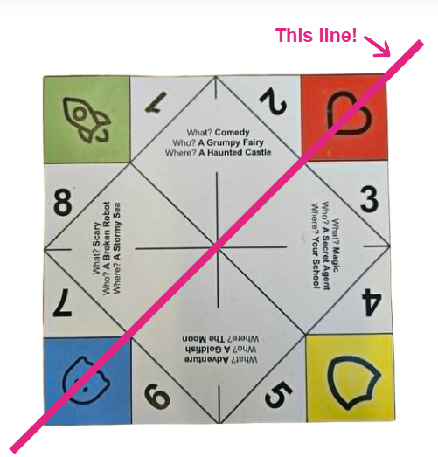

Step 2: Fold in half diagonally
scottishbooktrust.com

Slide 18
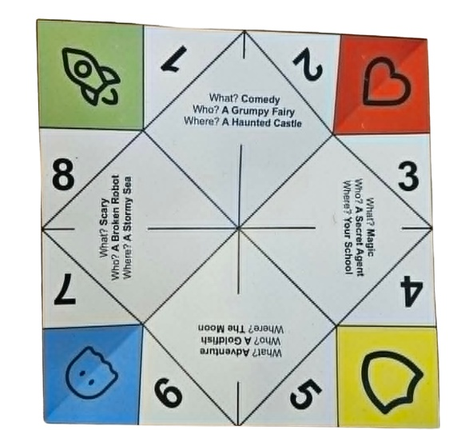
Step 3: Unfold back to normal
scottishbooktrust.com

Slide 19
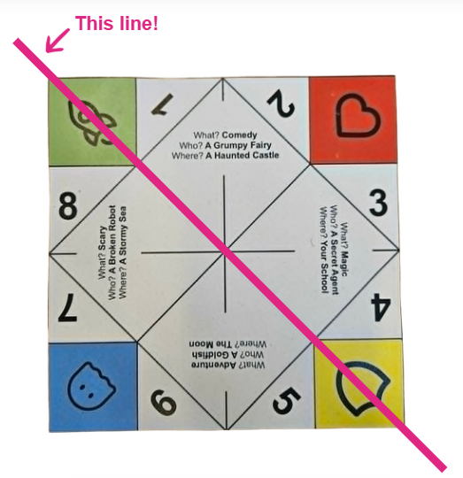

Step 4: Fold diagonally the other way
scottishbooktrust.com

Slide 20
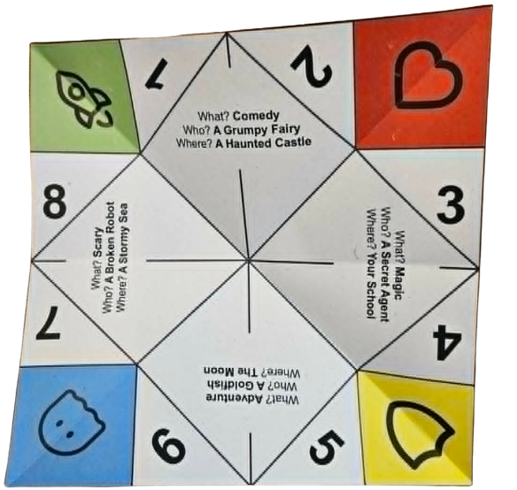
Step 5: Unfold back to normal again
scottishbooktrust.com

Slide 21
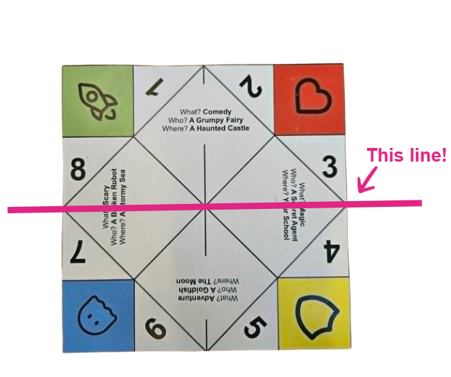

Step 6: Fold in half
scottishbooktrust.com

Slide 22

Step 6: Unfold again, blank side facing up
scottishbooktrust.com

Slide 23


Step 7: Fold each corner into the centre
scottishbooktrust.com

Slide 24
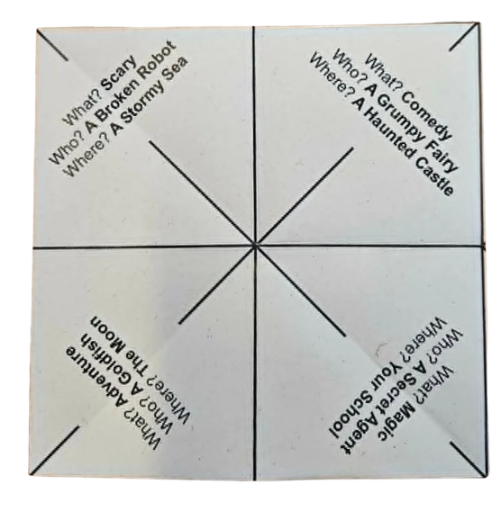
Step 8: Turn over (text side up)
scottishbooktrust.com

Slide 25
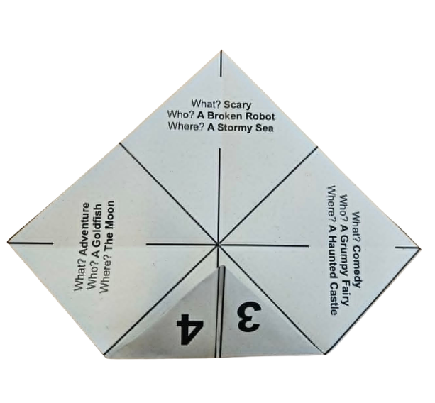

Step 9: Fold each corner into the centre again
scottishbooktrust.com

Slide 26
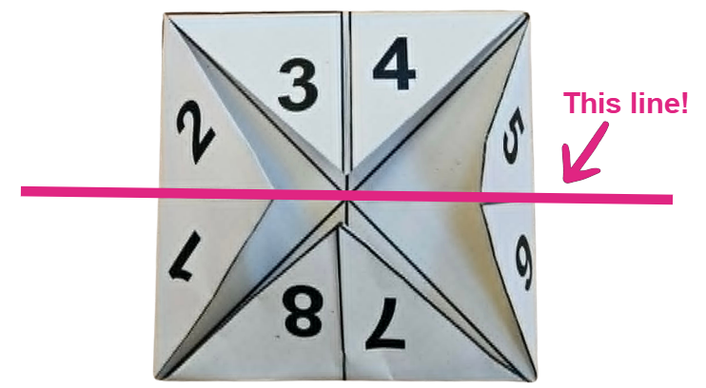

Step 10: Fold in half so your coloured squares face out
scottishbooktrust.com

Slide 27
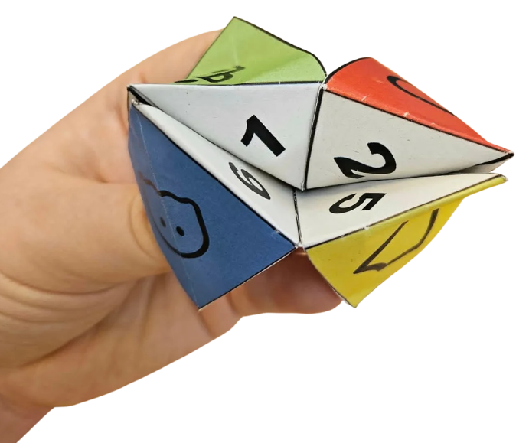
Step 11: Put your fingers under each coloured square and pinch!
scottishbooktrust.com

Slide 28
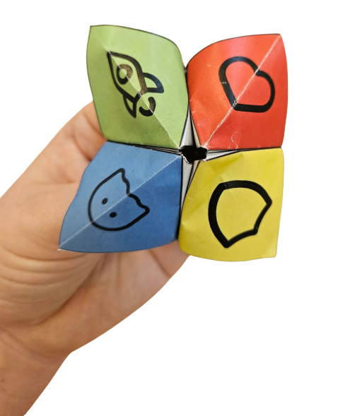
Step 12: Your fortune teller is complete. Are you ready to discover your story?
scottishbooktrust.com

Slide 29
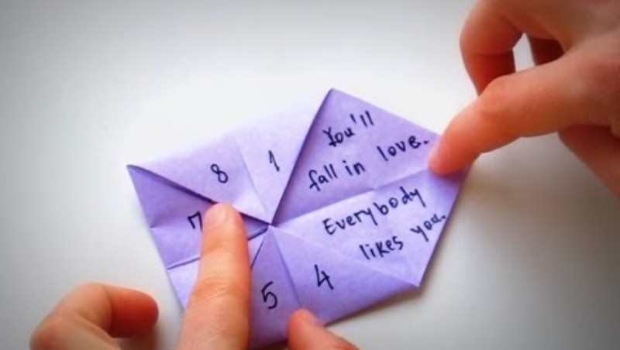
Watch this video to learn how to get your story from your fortune teller.
scottishbooktrust.com

Slide 30
Now to find your story!
Tell your fortune three times to pick out:
What kind of story (comedy, magic, adventure, scary)
Who is in the story (a grumpy fairy, a secret agent, a goldfish, a broken robot)
Where the story takes place (a haunted castle, a stormy sea, the moon, your own school)
scottishbooktrust.com

Slide 31
The story game: share your story!
Now you can share your story with your class or with a partner.
scottishbooktrust.com

Slide 32
Activity 3:
Write the sequel
scottishbooktrust.com

Slide 33

Activity 3: Write the sequel
A great way to start storytelling is to find a story you already love and then ask yourself: what happened next?
In pairs, talk about a story you already love. Why do you like it?
scottishbooktrust.com

Slide 34
Fill in your activity sheet
The story I loved is…
What is the title?
Where is it set?
Who is in it?
Now, think about what happens next!
scottishbooktrust.com

Slide 35
Write the sequel: share your story!
Now you can share your story with your class or with a partner.
scottishbooktrust.com

Slide 36
Activity 4:
A day in the life
scottishbooktrust.com

Slide 37
Activity 4: A day in the life
Can you imagine being someone completely different?
Pick one of the characters on the next slide, then imagine how your day would be. You could:
Write a story
Write a diary entry
Draw a comic!
scottishbooktrust.com

Slide 38


Choose your character…
A lost alien
A unicorn herder
A computer game villain
A dinosaur who is scared of everything
A grumpy princess
A mouse living in a sporran
The king of Asteroid City
scottishbooktrust.com

Slide 39
A day in the life: share your story
Which character did you pick? Why?
Which kind of story did you write (story, diary entry, comic)? Why?
Share your story with a partner!
scottishbooktrust.com

Slide 40
Coming up with your own characters
To create your own characters, come up with a list of adjectives and a list of nouns. You could then use these to create your own characters, for example:
Adjectives | Nouns
Brave | Hamster
Graceful | Astronaut
Shy | Goblin
Noisy | Baker
Clumsy | Butterfly
scottishbooktrust.com

Slide 41


Thank you
scottishbooktrust.com
Scottish Book Trust is a national charity changing lives through reading and writing. Registered company SC184248 | Scottish charity SC027669

